Slide 1
Big 10 Universities Environment Analysis

Slide 2


City environments can affect the mental health of college students and therefore should be an important factor when choosing schools

Slide 3




Finding a school that allows the types of hobbies and personalities of the student, and gives them options to choose from, can allow to increase self-care activities.

Slide 4
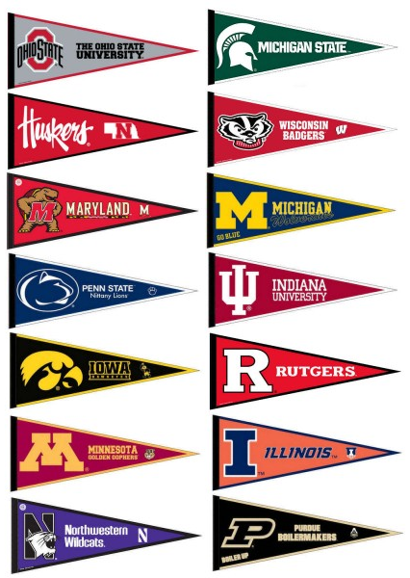


Slide 5
PERCENTAGE OF VENUES ON EACH SCHOOL

Slide 6
School | Location | 1st Most Common Venue | 2nd Most Common Venue | 3rd Most Common Venue | 4th Most Common Venue | 5th Most Common Venue | 6th Most Common Venue | 7th Most Common Venue | 8th Most Common Venue | 9th Most Common Venue | 10th Most Common Venue
Northwestern University | Evanston, IL | Park | Grocery Store | Coffee Shop | Beach | Pizza Place | Bakery | Hot Dog Joint | Cafe | Mexican Restaurant | Mediterranean Restaurant
University of Michigan | Ann Arbor, MI | Grocery Store | Park | Coffee Shop | Gym | Mexican Restaurant | Breakfast Spot | Bakery | Music Venue | Bookstore | Vegetarian / Vegan Restaurant
University of Minnesota | Minneapolis, MN | Brewery | Park | Theater | Pizza Place | Liquor Store | Mexican Restaurant | Coffee Shop | Vietnamese Restaurant | New American Restaurant | Farmers Market
University of Maryland | College Park, MD | Grocery Store | Brewery | American Restaurant | Pizza Place | Coffee Shop | Convenience Store | Gym | Italian Restaurant | Burger Joint | Salad Place
University of Wisconsin | Madison, WI | Bar | Pizza Place | Sandwich Place | Convenience Store | Golf Course | Liquor Store | Brewery | Park | Fast Food Restaurant | Mexican Restaurant
The Ohio State University | Columbus, OH | Park | Pizza Place | Grocery Store | Coffee Shop | Ice Cream Shop | American Restaurant | Cafe | Bar | Italian Restaurant | Bookstore
Penn State University | University Park, PA | Cafe | American Restaurant | Hotel | Salon / Barbershop | Park | Coffee Shop | Ice Cream Shop | Pool | Thai Restaurant | Gas Station
Rutgers University | New Brunswick, NJ | Pizza Place | Bakery | Coffee Shop | Italian Restaurant | Chinese Restaurant | Mediterranean Restaurant | Supermarket | Burger Joint | Bubble Tea Shop | Pet Store
Purdue University | West Lafayette, IN | Coffee Shop | Mexican Restaurant | Sandwich Place | Bakery | Grocery Store | Burger Joint | Park | Pizza Place | Bar | Cafe
University of Illinois | Champaign, IL | Mexican Restaurant | Cosmetics Shop | BBQ Joint | Clothing Store | American Restaurant | Steakhouse | Coffee Shop | Pizza Place | Bar | Chinese Restaurant
Michigan State University | East Lansing, MI | Coffee Shop | Sushi Restaurant | Bar | Grocery Store | American Restaurant | Salon / Barbershop | Ice Cream Shop | Middle Eastern Restaurant | Yoga Studio | Gym / Fitness Center
University of Nebraska-Lincoln | Lincoln, NE | Mexican Restaurant | Brewery | Coffee Shop | Burger Joint | Chinese Restaurant | Pizza Place | Bakery | Fried Chicken Joint | Grocery Store | Park
Indiana University | Bloomington, IN | Pizza Place | Grocery Store | Fast Food Restaurant | Gym / Fitness Center | Gym | American Restaurant | Brewery | Ice Cream Shop | Mexican Restaurant | Pharmacy
University of Iowa | Iowa City, IA | Grocery Store | American Restaurant | Pizza Place | Coffee Shop | Gas Station | Bakery | Ice Cream Shop | Italian Restaurant | Diner | Burrito Place

Slide 7
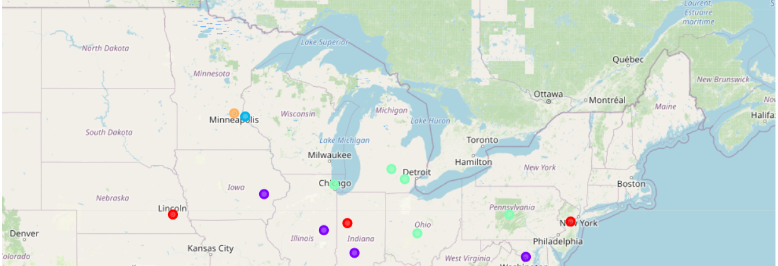
Clusters by Profile

Slide 8







Most Common Venues:
High amounts of outdoors and recreation, as well as shop and service venues.
Parks, coffee shops and grocery stores are common
Insights into personalities:
Agreeable to most personalities yet, may not have as much activities for extroverted people.
Good for people who like outdoor activities.

Slide 9



Most Common Venues:
High amounts of food venues. Limited in most other choices.
Insights into personalities:
Agreeable to adaptable personalities. Not the best for people who is passionate about culture or outdoor activities.

Slide 10




Most Common Venues:
Good balance between all types of venues good access to several kind of activities.
Insights into personalities:
Agreeable to all personalities.

Slide 11

Most Common Venues:
Highest amount of nightlife spots
Insights into personalities:
Better for extroverted personalities, specially those who enjoy dancing and partying.

Slide 12

Most Common Venues:
Higher amount of arts and entertainment venues and professional places, in comparison to all other universities
Insights into personalities:
Agreeable to all personalities, specially those interested in cultural activities.

